Slide 1


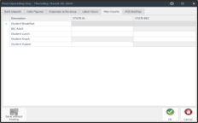



Newton Front of the House Overview

Slide 2


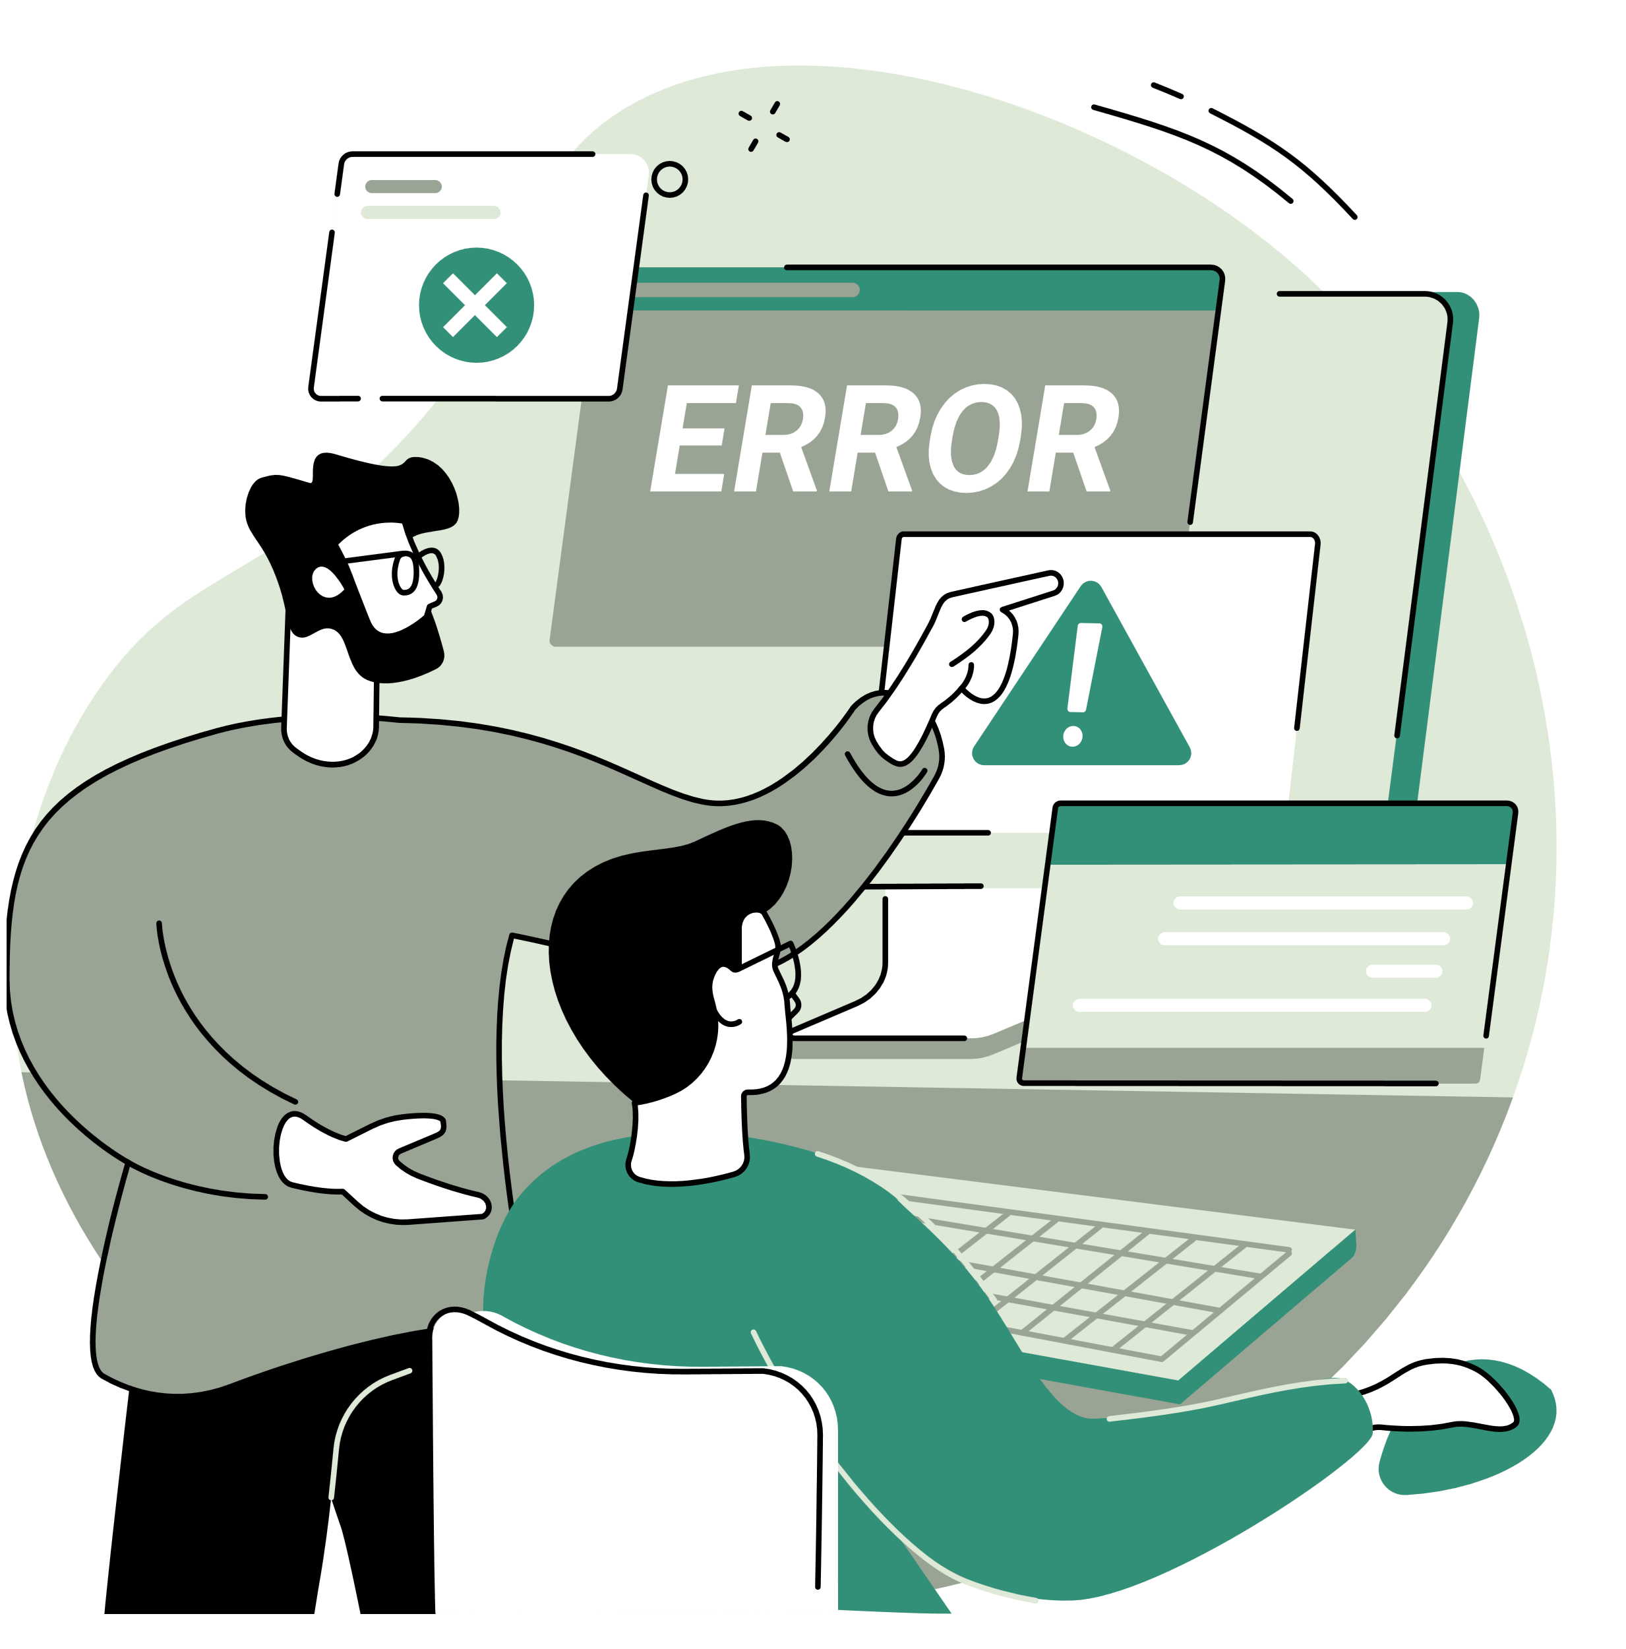

Agenda
  DAY IN THE LIFE OF A CAFETERIA MANAGER
  COMMON ERRORS AND HOW TO TROUBLESHOOT
  NEW NEWTON VERSION
.

Slide 3

Day in the life of a Cafeteria Manager

Slide 4
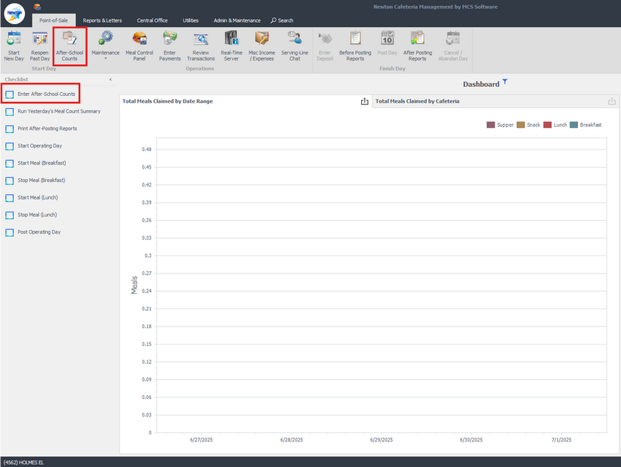
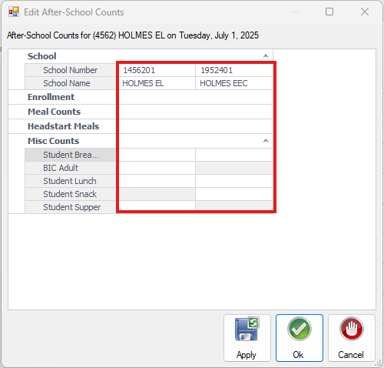
Enter After School Counts
From the Checklist or the Ribbon
Click on “Enter After-School Counts”
Last operating day box will open.
Enter Supper/Snack specific to your site and click “OK”

Slide 5
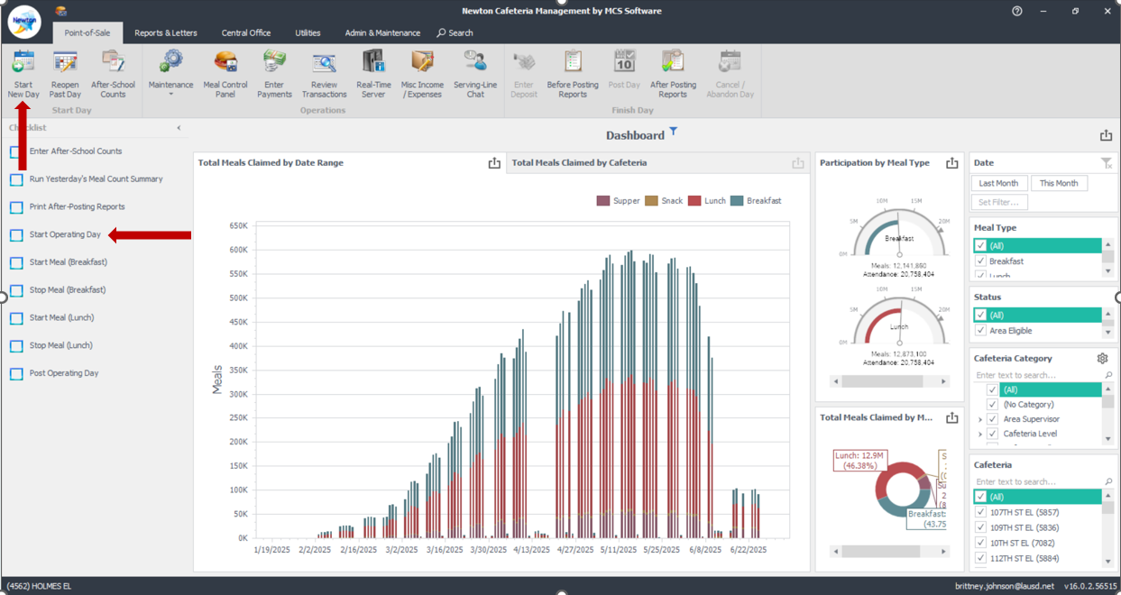
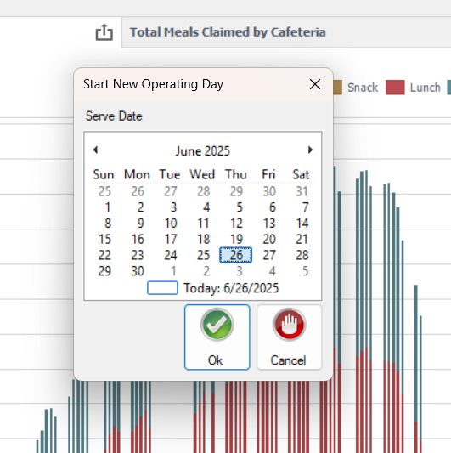
Starting your Day
From ribbon or checklist Click “Start Operating Day”
Ensure correct date is selected, and Click “Ok”

Slide 6
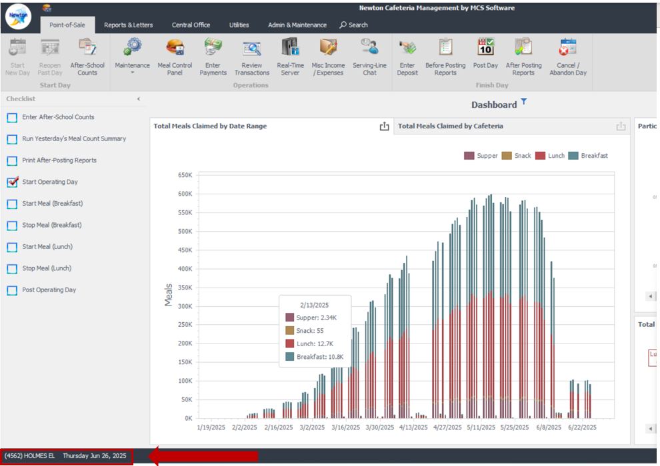
Starting your Day-Continued
A check mark will show on “Start Operating Day”
Bottom Ribbon displays
Location Code
Site Name
Current Date Open

Slide 7
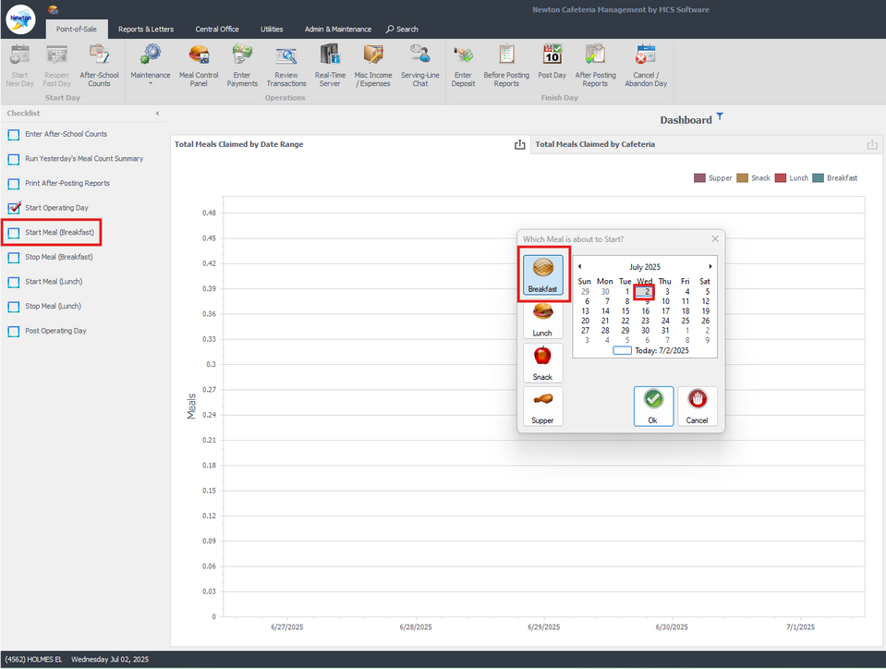
Begin Your Meal Service
1. Click “Start Meal Breakfast / Lunch”
Verify correct Meal Service & date is selected.
2. Click “OK”.
(Example is showing breakfast)

Slide 8
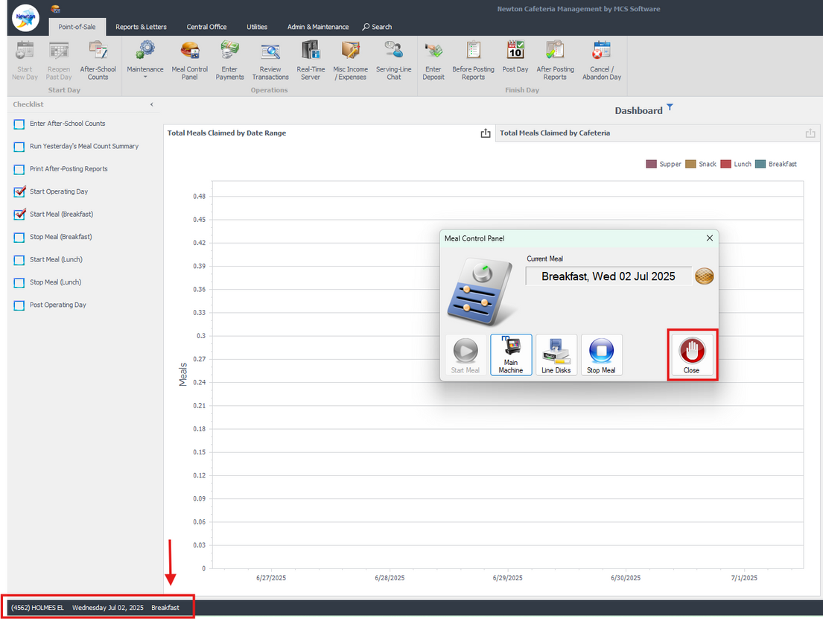
Begin Your Meal Service
Start Meal Breakfast will be checked.
Meal Control Box will generate “Click Close”.
Bottom Ribbon displays current Open Date & Meal Service
Note: Employee meals
(see next slide)

Slide 9
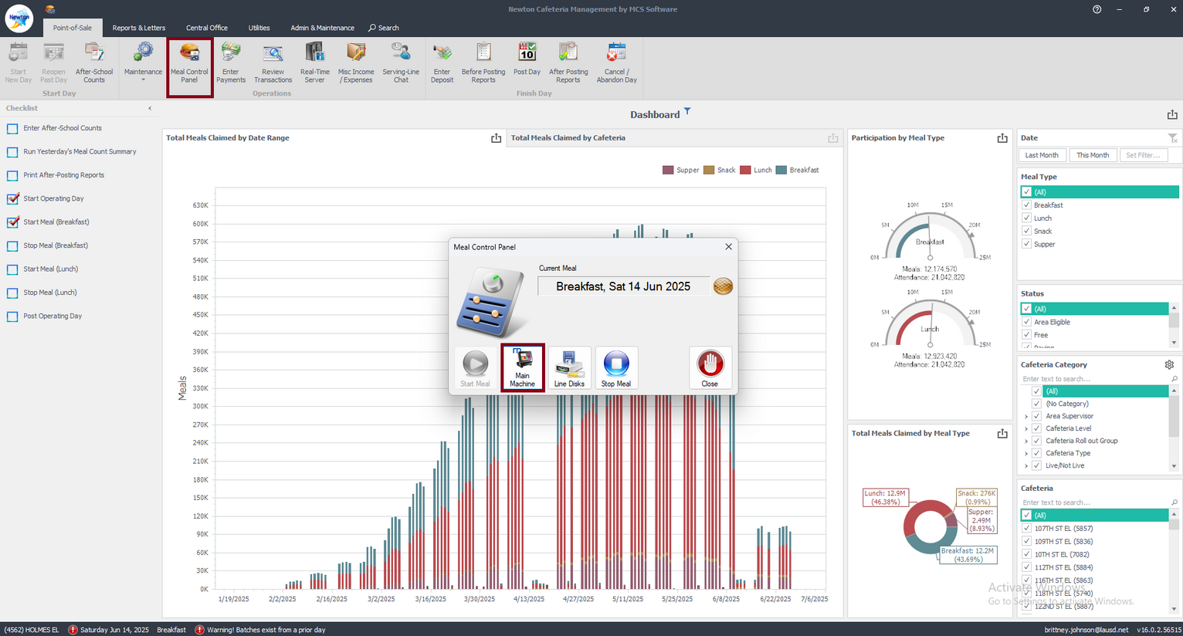
Enter Employee Meals
1. On “Point Of Sale Tab” Select “Meal Control Panel”
2. Select (Main Machine) on managers terminal before ending breakfast or lunch service.

Slide 10
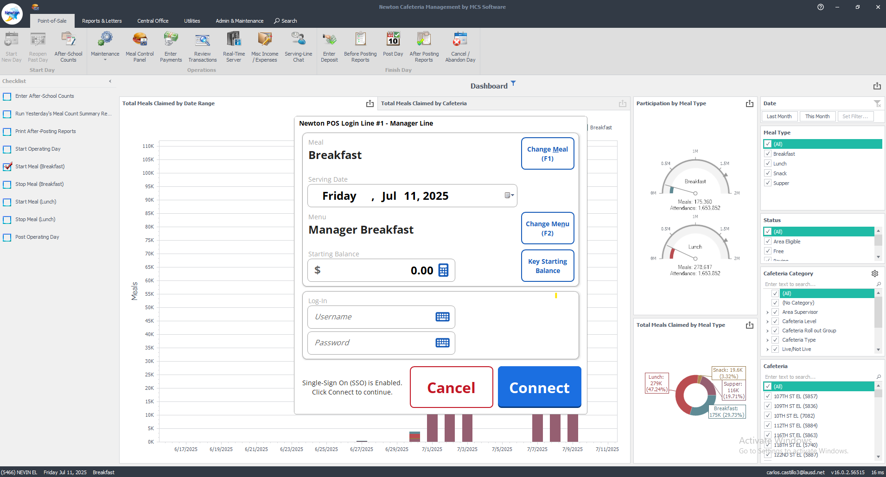
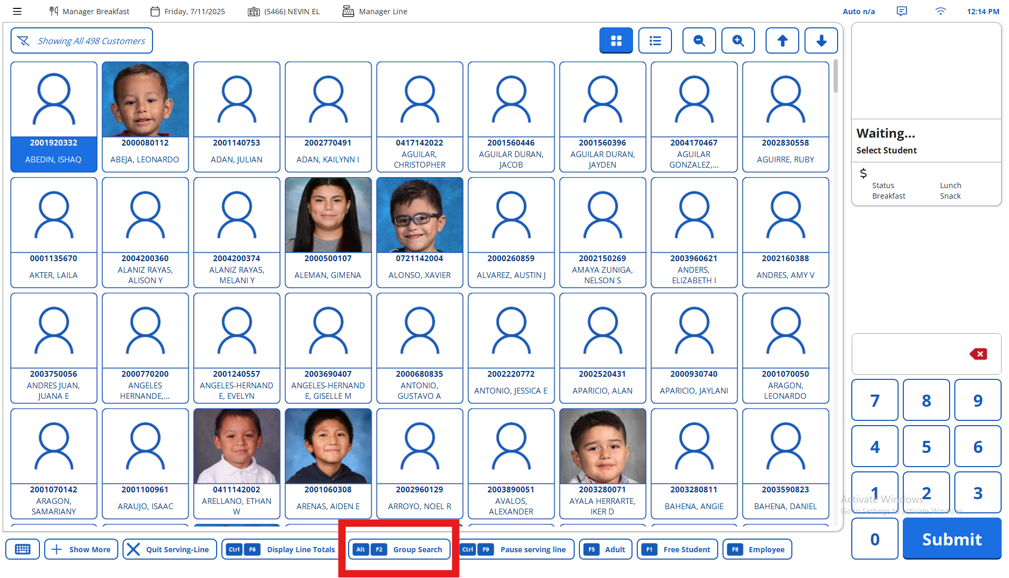
Enter Employee Meals -Continued
3.Verify correct meal service and date then Select “Connect”
4.To Find Employee
Select
“ Group Search”

Slide 11
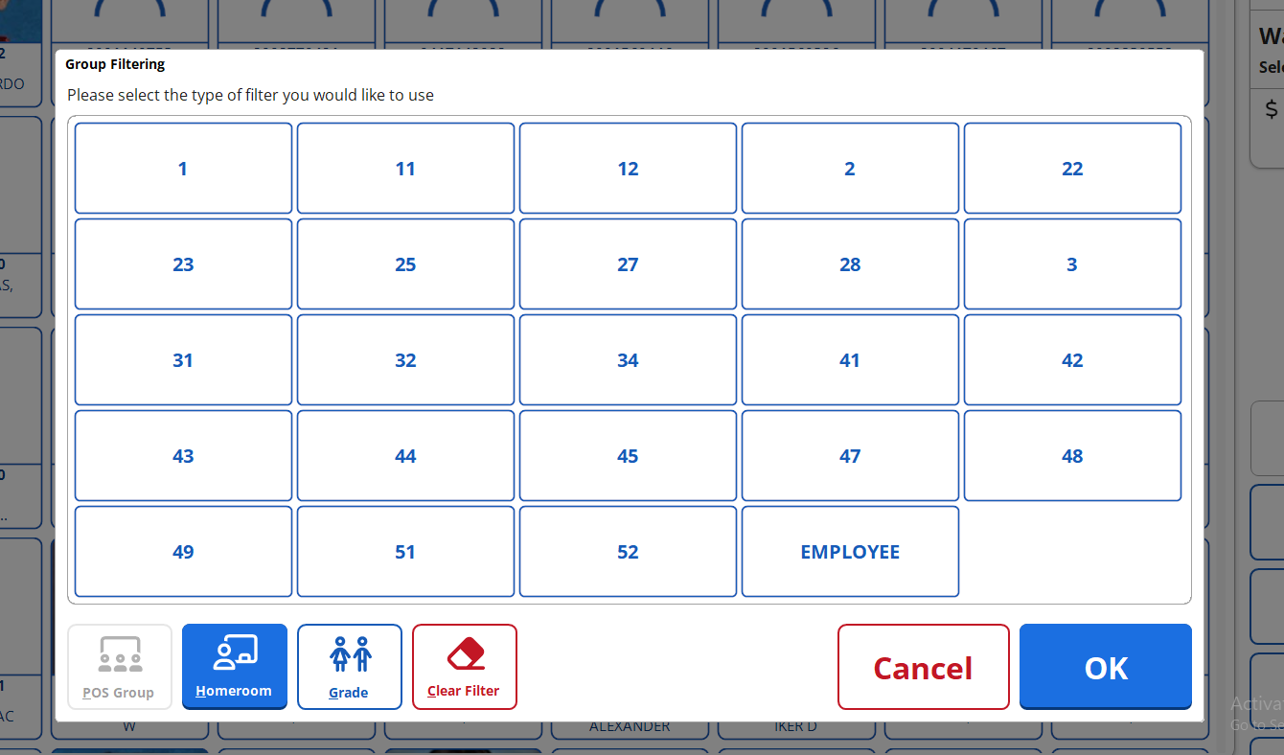
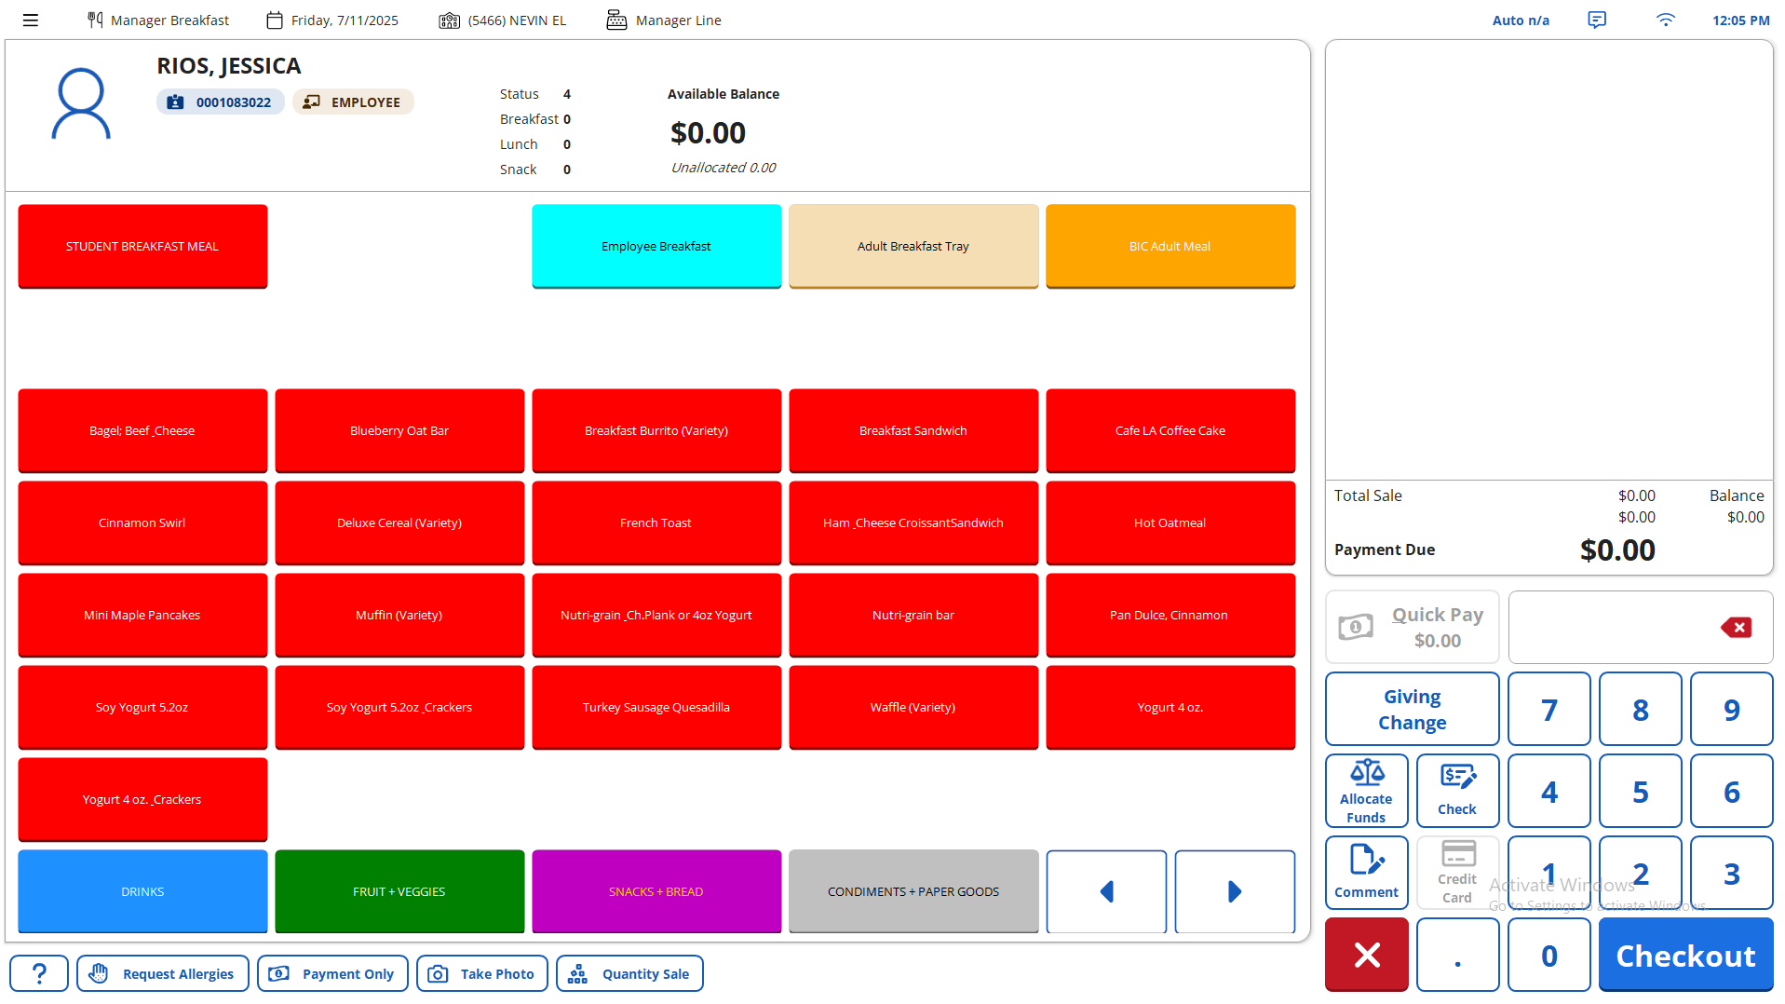
Enter Employee Meals -Continued
5. Sort by "Homeroom", then select “Employee” from the window
6. Select Employee and click on “Employee Breakfast/ Lunch” and click “OK”

Slide 12
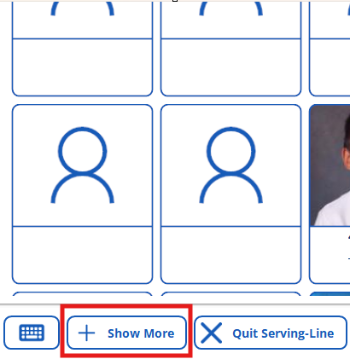
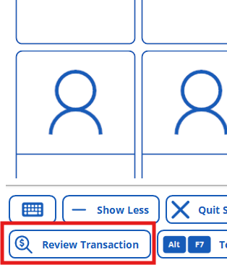
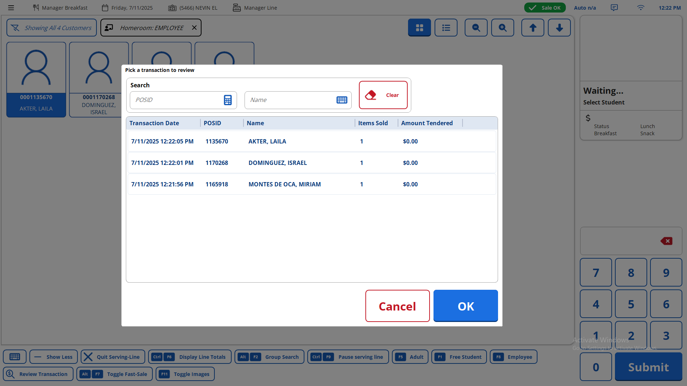
Enter Employee Meals -Continued
Note: Review Transactions to review employee meal claimed
Happy Employee 12
Happy Employee 25
Happy Employee 1
Click Show More
2. Click on Review Transaction
3. See Transaction Displayed

Slide 13
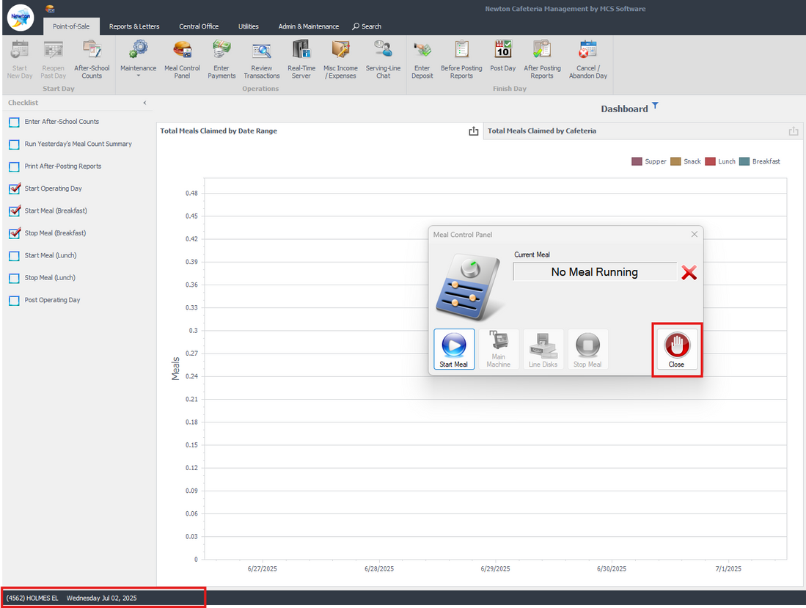
Closing Your Meal Service
  1. Cashier must “Quit Serving Line” and “Exit Point of Sale”.
2. Click “Stop Meal Breakfast / Lunch
3. Current meal displays “No Meal Running” click “Close”

Slide 14
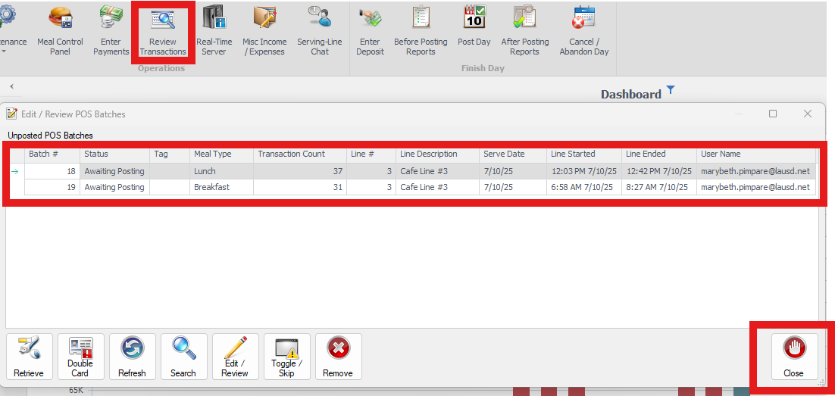
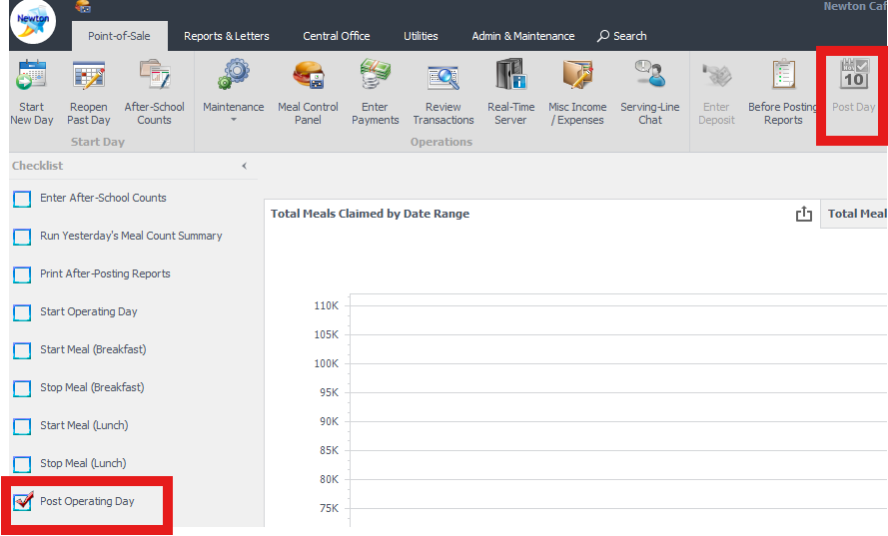
Posting Operating Day
Note: Verify that all POS are closed by "Quit Serving Line" and "Exit Point of Sale" (door) by Cashier. From manager machine Stop Meal.
Click on “Review Transactions” and verify batch status displays “Awaiting Posting”
View “Transaction Count” for meal count
3. Click on “Post Operating Day” on check list or
“Post Day” on the ribbon.

Slide 15
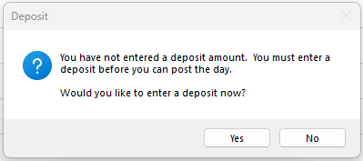
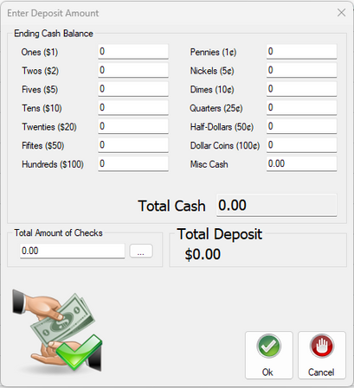
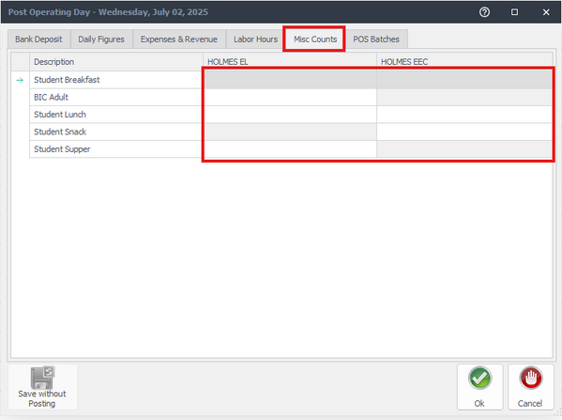
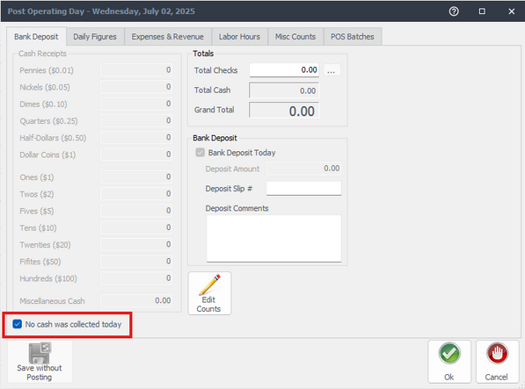
Posting Operating Day-Continued
4. Click 'Yes' to proceed with the deposit, even if no money is being deposited
5. Enter Ending Cash Balance ,if Zero Total Cash leave the field/s blank and click 'OK’
7. Select “Misc Count” tab, enter meal counts not captured at POS.
Main Site with Offsite or EEC enter meal counts under site tab
Select tab “Daily figures” after entering meals.
If no meal served select "No service" to avoid flagging on missing meals.
6. Enter deposit slip # in field, and type “Bank bag #’ in the Comment box
If no deposit, click on “No cash was collected today”

Slide 16
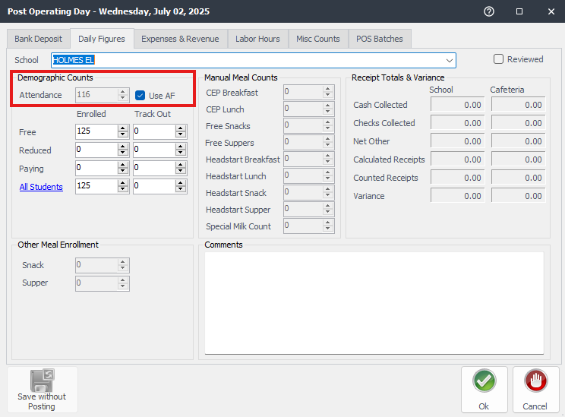
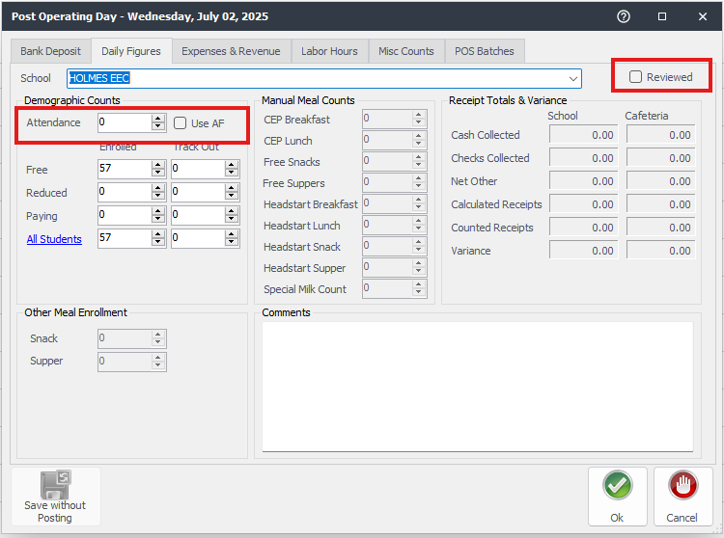
Posting Operating Day-Continued
8. If you have no offsite locations, verify that there are no variances, click on the “Reviewed” check box, and click “OK.”
9.Under main site click on the “AF” checkbox to generate attendance, click the “reviewed” check box and continue to the next school by selecting it in the dropdown.
If you do have offsites, you must review each entry in the “School Dropdown” individually
Under offsite you must update attendance and enrollment (if needed) Leave “AF” box unchecked, click on the “Reviewed” check box and
click “OK.”

Slide 17
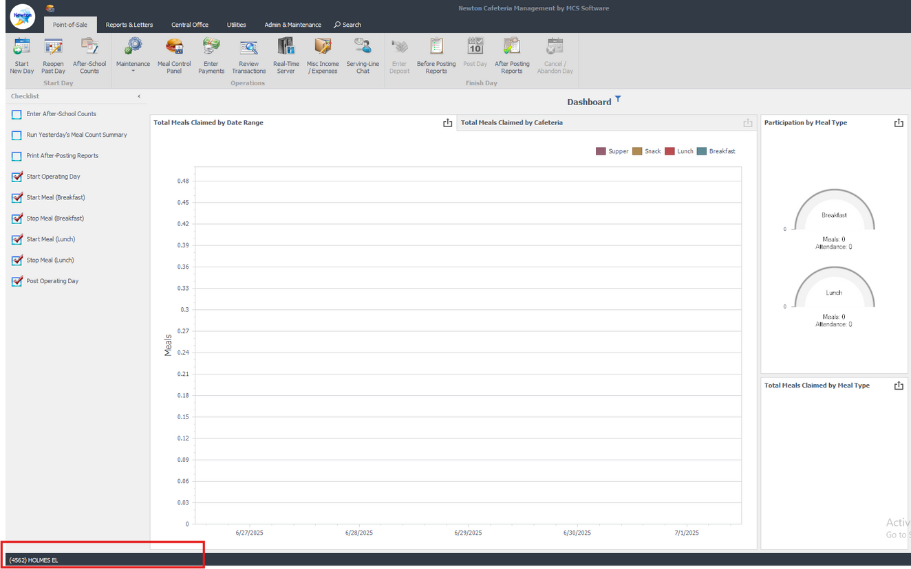

Posting Operating Day-Continued
Success! Day is now Posted
Only the site name should appear in the bottom left corner— the date should no longer be visible. This confirms that the day is successfully posted.

Slide 18
“AF” - Attendance Factor and Edit Check
The attendance factor represents the percentage of enrolled students who are expected to be present on a typical school day. Attendance factor at LAUSD is 92.1 %
  If meal count exceeds AF or enrollment, site will flag in edit check report
If AF is higher than 92.1 % at your Main Site, Central Office can update AF by submitting a letter/email from school administrator (submit a service now)
  CSPP, EEC, OFFSITES - Must enter enrollment daily to avoid flagging

Slide 19
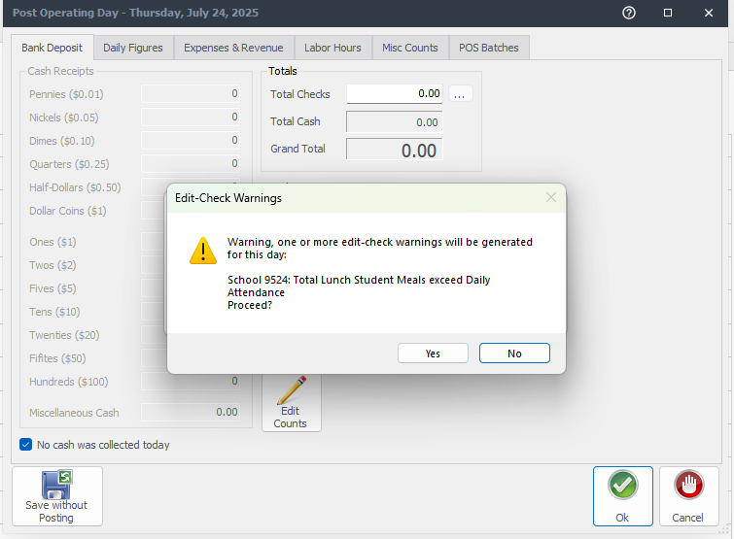
“AF” - Attendance Factor and Edit Check-Continued
If edit check flags a site, see steps below
  Review Meal Count Summary
  If Main Site Meal Counts are correct submit a service now request to correct enrollment for site
  Review EEC/OFFSITE Enrollment and Attendance Count

Slide 20
Common Errors and troubleshooting
  Batch Status Overview
    Awaiting posting
    In progress
    Interrupted
    Skipped
  Checklist explanation - Checklist is a shortcut of ribbons
  Connectivity Issues - WIFI / IP address
  Missing meals
Notes:
Presenter : Talking Point

Slide 21
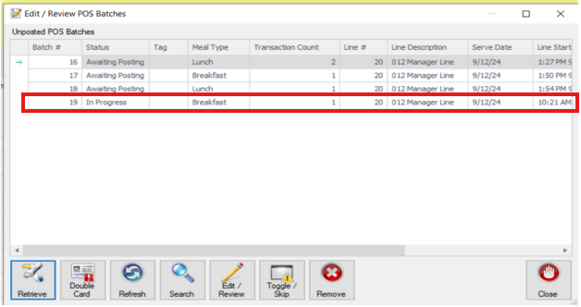
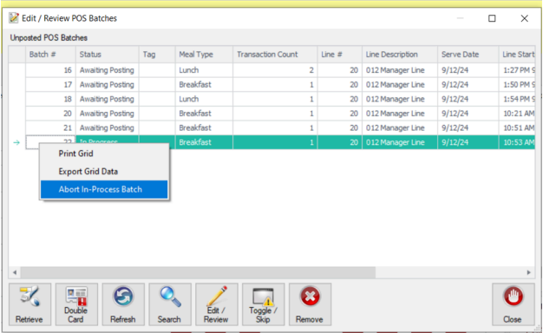
Batch Overview
Under review transactions you can review all existing batches.
If you have a batch status “In Progress” cashier needs to Quit Serving Line to update batch status to “Awaiting Posting”
If cashier is no longer available to quit serving line. You can manually stop the batch by right clicking the batch and selecting “Abort In Process Batch”

Slide 22
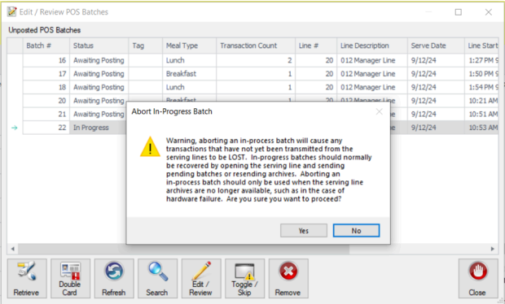
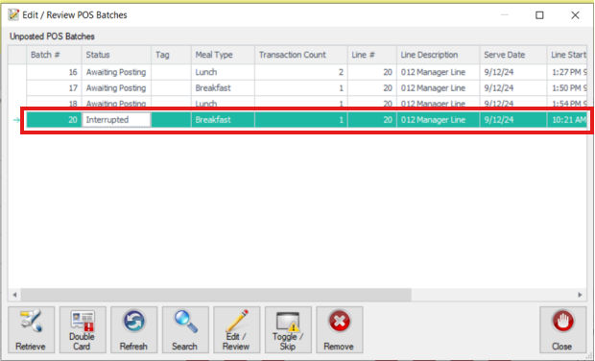
Batches Overview
Once you click “Yes” the batch will become “Interrupted “
Once the batch is “Interrupted” right click on the batch again and select “Recover Interrupted Batch”
This will change the batch to “Awaiting Posting” and the system will allow you to post operating day

Slide 23
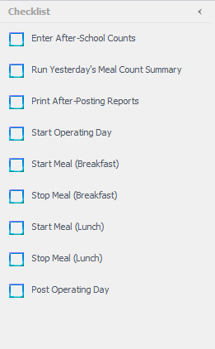

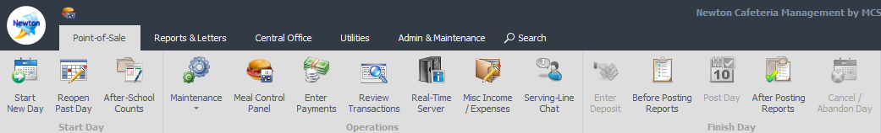
Checklist Overview
Checklist is a shortcut to help managers with their day-to-day operation
Checklist does not have to be completed to post operating day
You can check and uncheck each box and this will not have any effect on your operating day

Slide 24
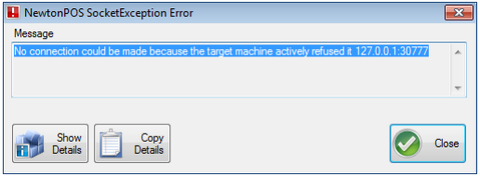
POS Connectivity Issues
If POS is Wireless always make sure you connect to LAUSD Wi-Fi before logging in to POS. If you log in to POS with no Wi-Fi connection, Newton POS will not work.

Slide 25
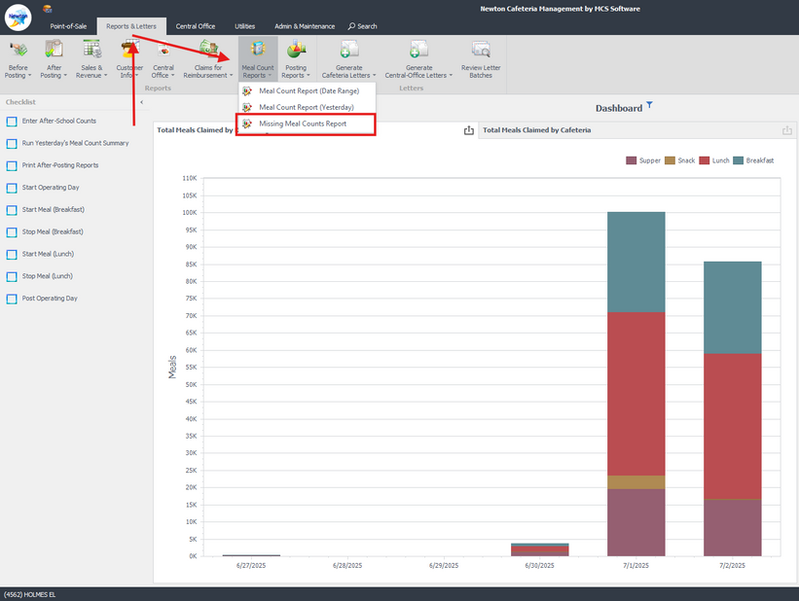
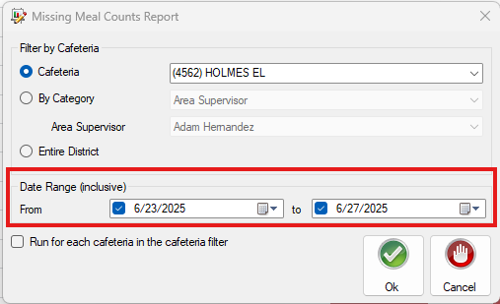
Missing Meal Count Report
Reports & Letters > Meal Count Reports > Missing Meal Count Reports
Run this report every Monday for previous week to Review Missing Meal Counts
Note: Missing Meal Display as(MISS)
Date Range, select the dates you want the report to view

Slide 26
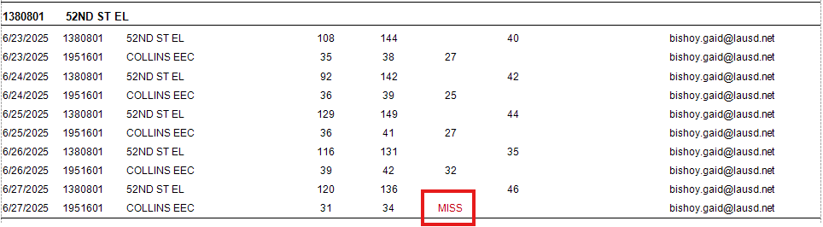
Missing Meal Count Report-Continued
HAPPY ELEMENTARY
HAPPY ELEMENTARY
NS
HAPPY EEC
HAPPY ELEMENTARY
HAPPY EEC
HAPPY ELEMENTARY
HAPPY EEC
HAPPY ELEMENTARY
HAPPY EEC
HAPPY ELEMENTARY
HAPPY EEC
Report will display Meal Counts not entered with “MISS” under Meal Type
Note: No Service will display as NS

Slide 27
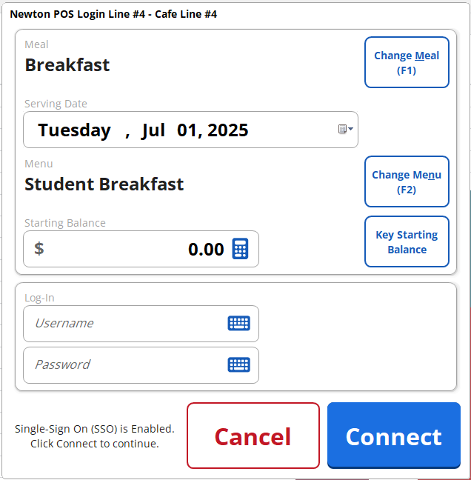
New Version for Newton FOH
New POS version will be rolling 2025-2026 school year.
- Same functionality as old version with new features.
New features added
- Updated Interface with enhanced view
- Zooming feature
- Simplified classroom selection

Slide 28
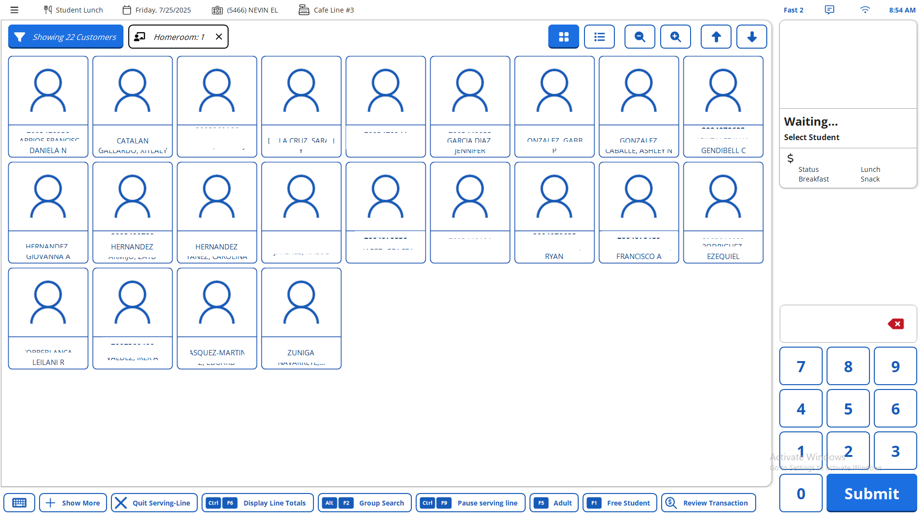
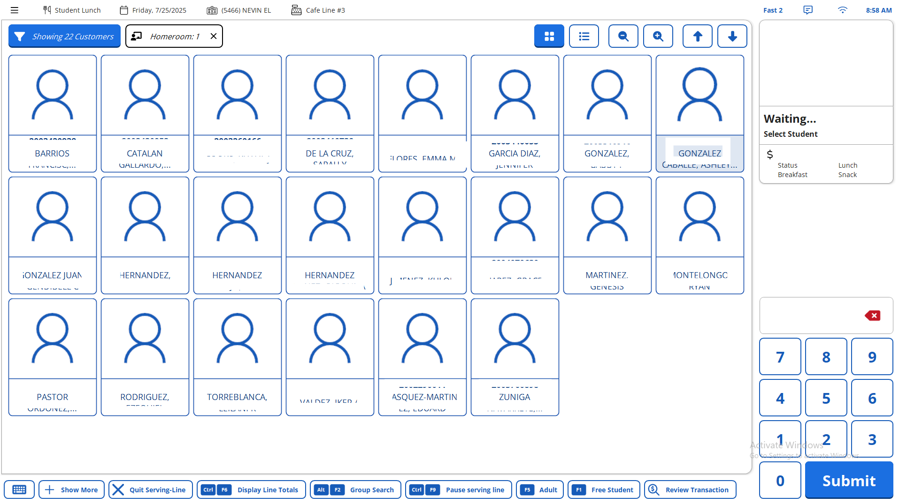
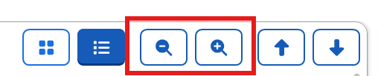
New Version for Newton FOH-Continued
Updated Interface with enhanced view
- Zoom feature
- Screen size can be adjusted by tapping the magnifying glass key button

Slide 29
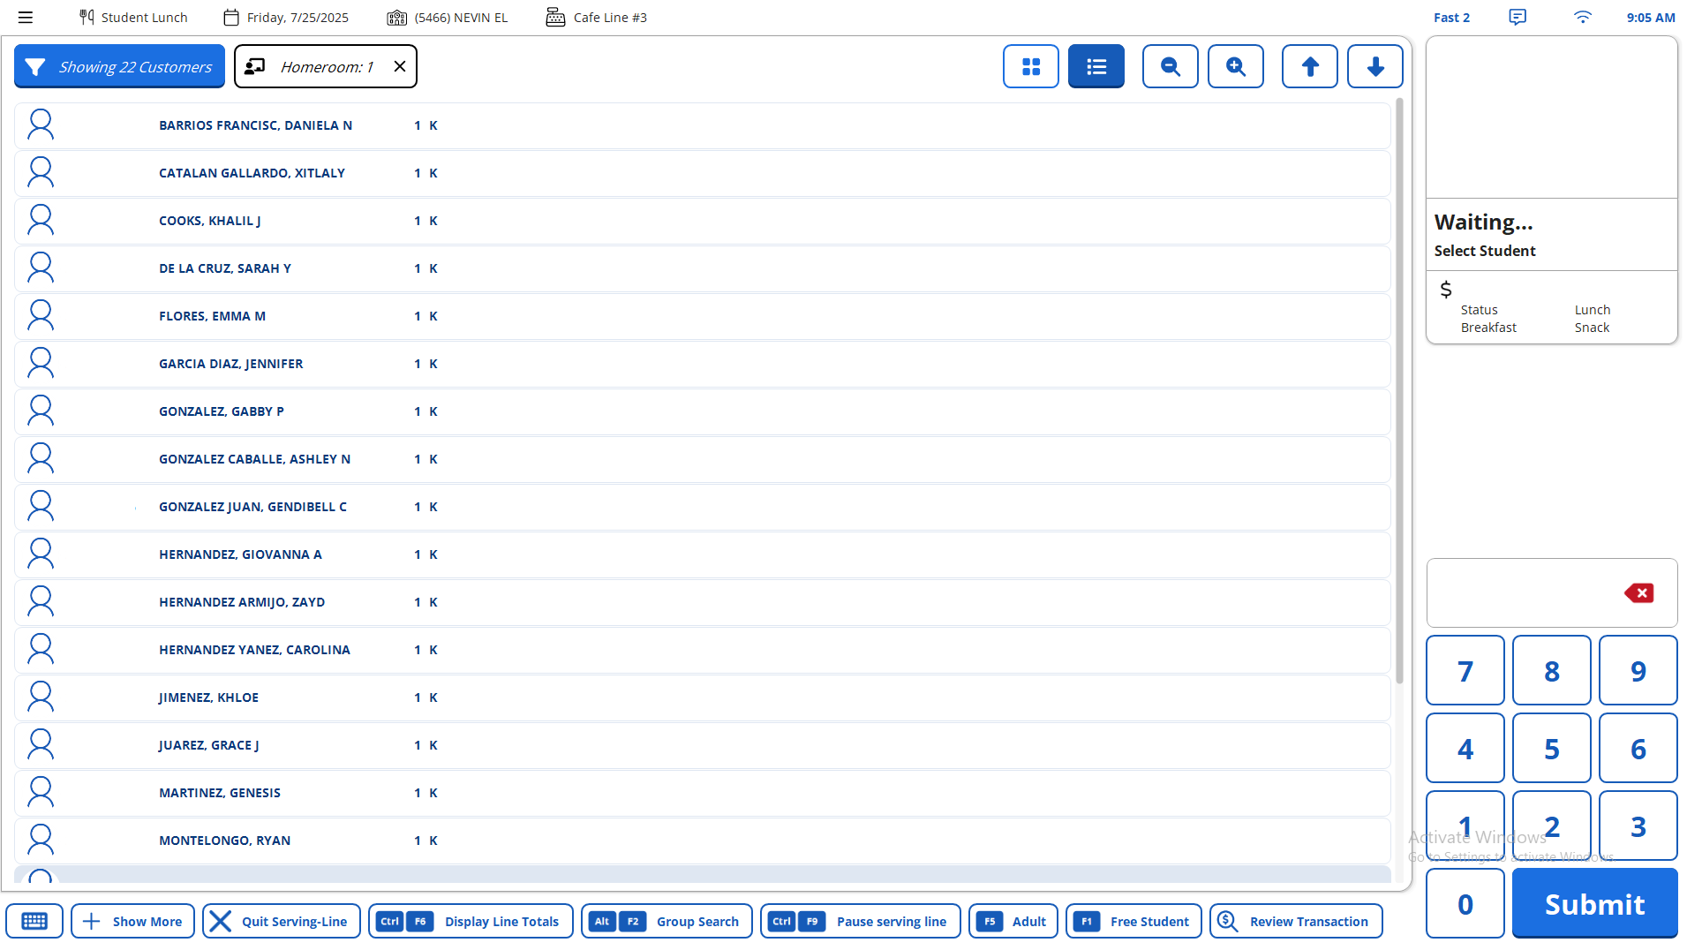
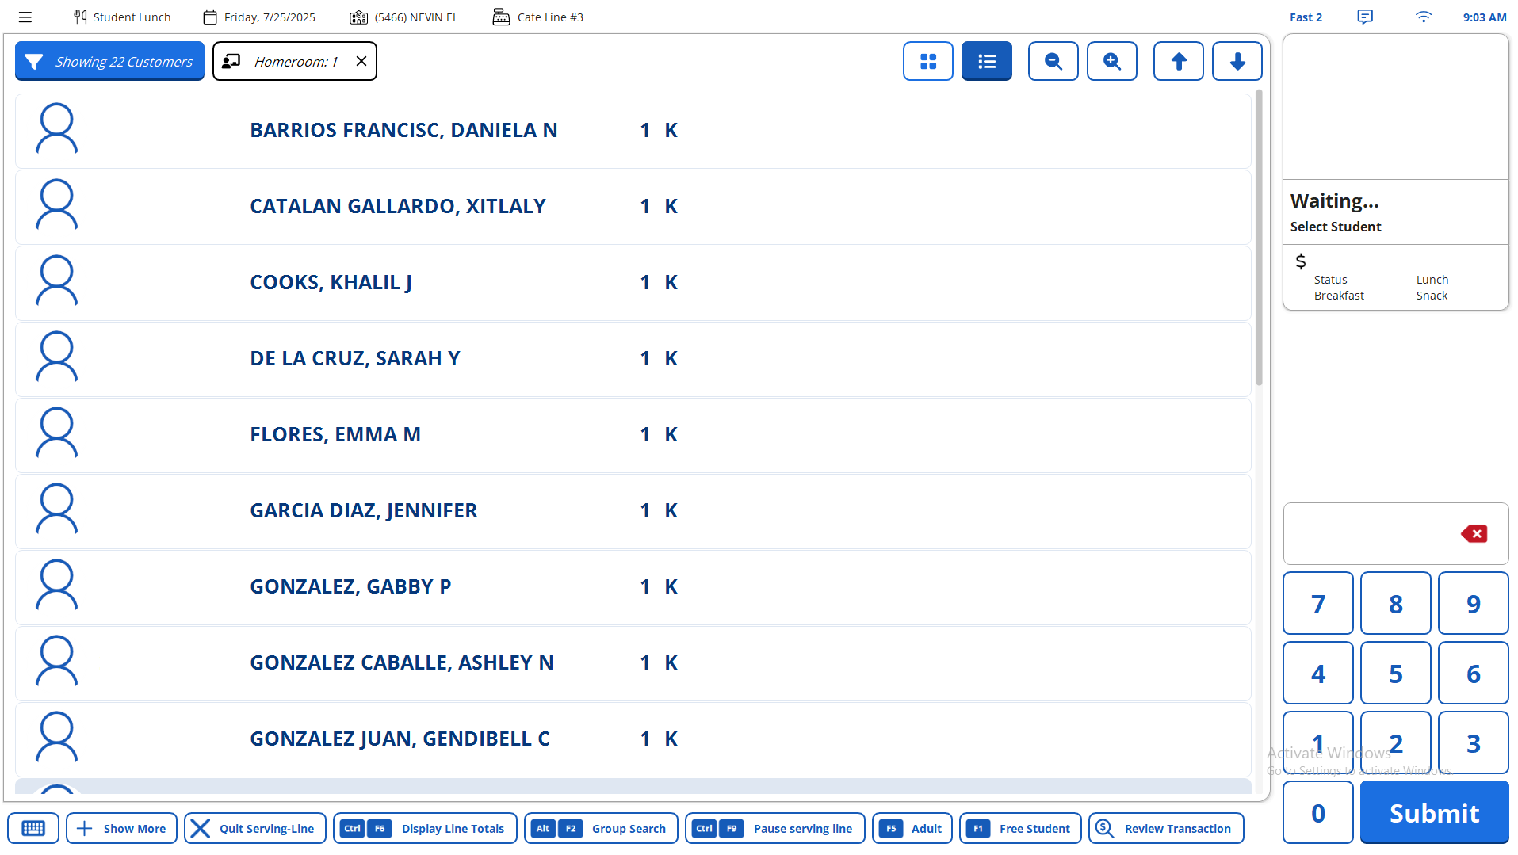
New Version for Newton FOH-Continued
Enhanced List View
- Zoom feature
- Screen size can be adjusted by tapping the magnifying glass key button
Notes:
Presenter – Talking Point

Slide 30
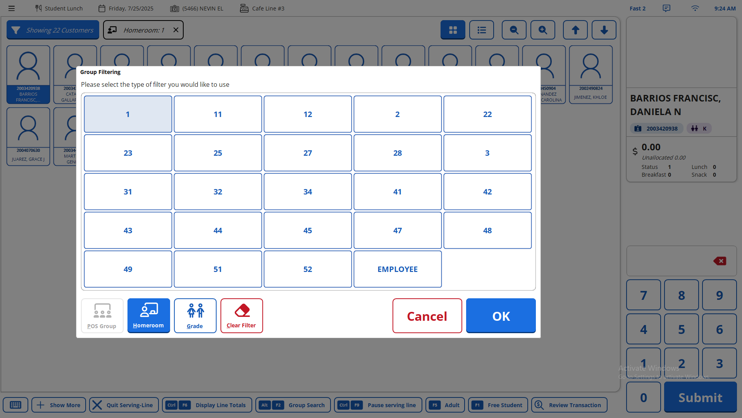
Simplified classroom selection

Slide 31

EDITING MEAL COUNTS IN NEWTON – IMPORTANT REMINDER
Sites allowed to edit meal count within the past 30 days
To edit Meal Count older than 30 days, you must:
Submit a "Service Now" (Describe in Detail) and your supervisor will be notified
This policy helps maintain data accuracy and accountability.
Enter meal count daily to avoid losing meals.
Once claim is submitted, we can no longer add meals.

Slide 32
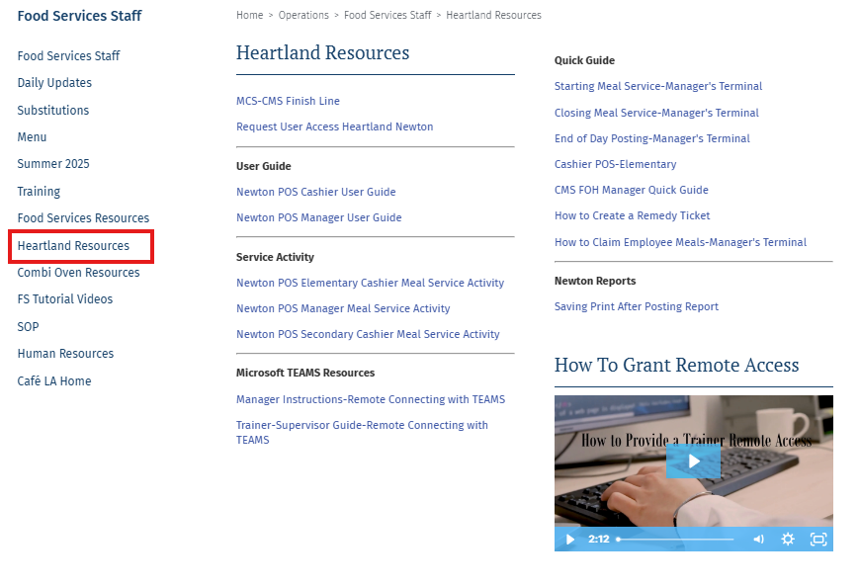
Heartland Resources
For additional Resources visit Café La Website “Heartland resources” page
CMS Help Desk 213-241-3002
Service Now

Slide 33



Thank you
Any Questions?
Notes:
Thank you everyone! If you have any questions, please raise your hand or enter it into the Chat. If no question feel free to email the CMS team and we can answer them.

